Slide 1

PREDICTIVE MAINTENANCE OF ENGINES

Slide 2
Introduction
Predictive maintenance focuses on the organization of maintenance actions according to the actual health state of the system, aiming at giving a precise indication of when a maintenance intervention will be necessary
In the aviation industry for instance, there is a large amount of information and maintenance data that could be used to obtain meaningful results in forecasting future actions. This study aims to introduce machine learning to predict failures of aircraft systems.
Accurate prediction of possible failures will increase the reliability of aircraft components and systems. The scheduling of maintenance operations help determine the overall maintenance and overhaul costs of aircraft components. Maintenance costs constitute a significant portion of the total operating expenditure of aircraft systems.

Slide 3
Predictive maintenance, as the name suggests, uses some parameters which are measured while the equipment is in operation to guess when failures might happen. It intends to interfere with the system before faults occur and help reduce the number of unexpected failures by providing the maintenance personnel with more reliable scheduling options for preventive maintenance. It focuses on the organization of maintenance actions according to the actual health state of the system, giving a precise indication of when a maintenance intervention will be necessary. The project aims to predict the failure of an engine by using Machine Learning to help improving productivity.

Slide 4
Problem Statement :
Predictive Maintenance of engines :
To build an ML model that should predict the failure of an engine beforehand itself.
In our statement it is mentioned that the model should predict the failure that is going to happen within the next 30 days.
Using this model build a webpage which allows users to enter the inputs manually or randomly assign its input values and predict the failure.

Slide 5
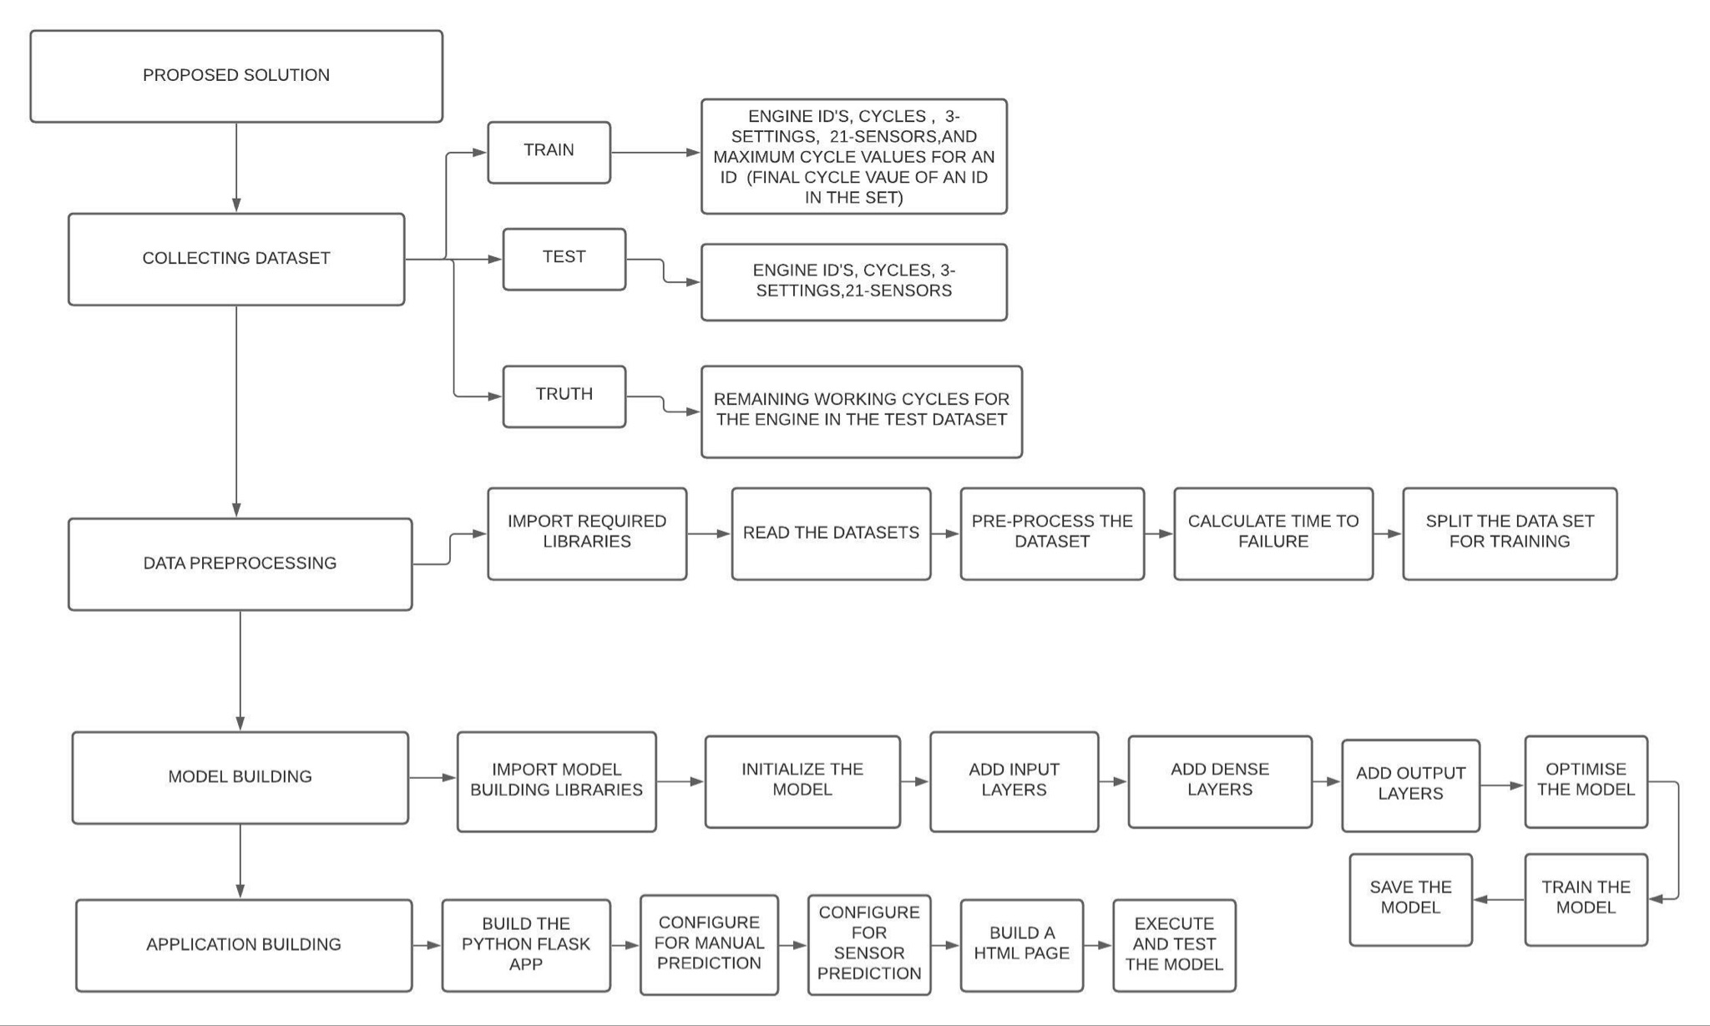
Solution approach:

Slide 6
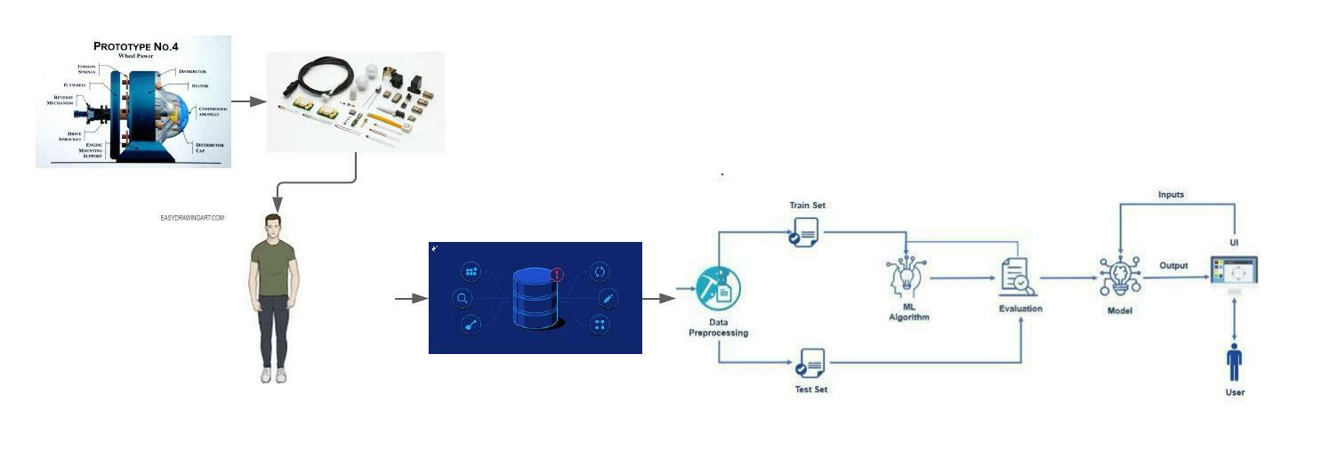
Flowchart of the project :

Slide 7
THANK YOU

